Slide 1

Candy Dataset Predicting the most preferred candy type
Sudha Udayakumar Sudha.udayakumar1@gmail.com

Slide 2
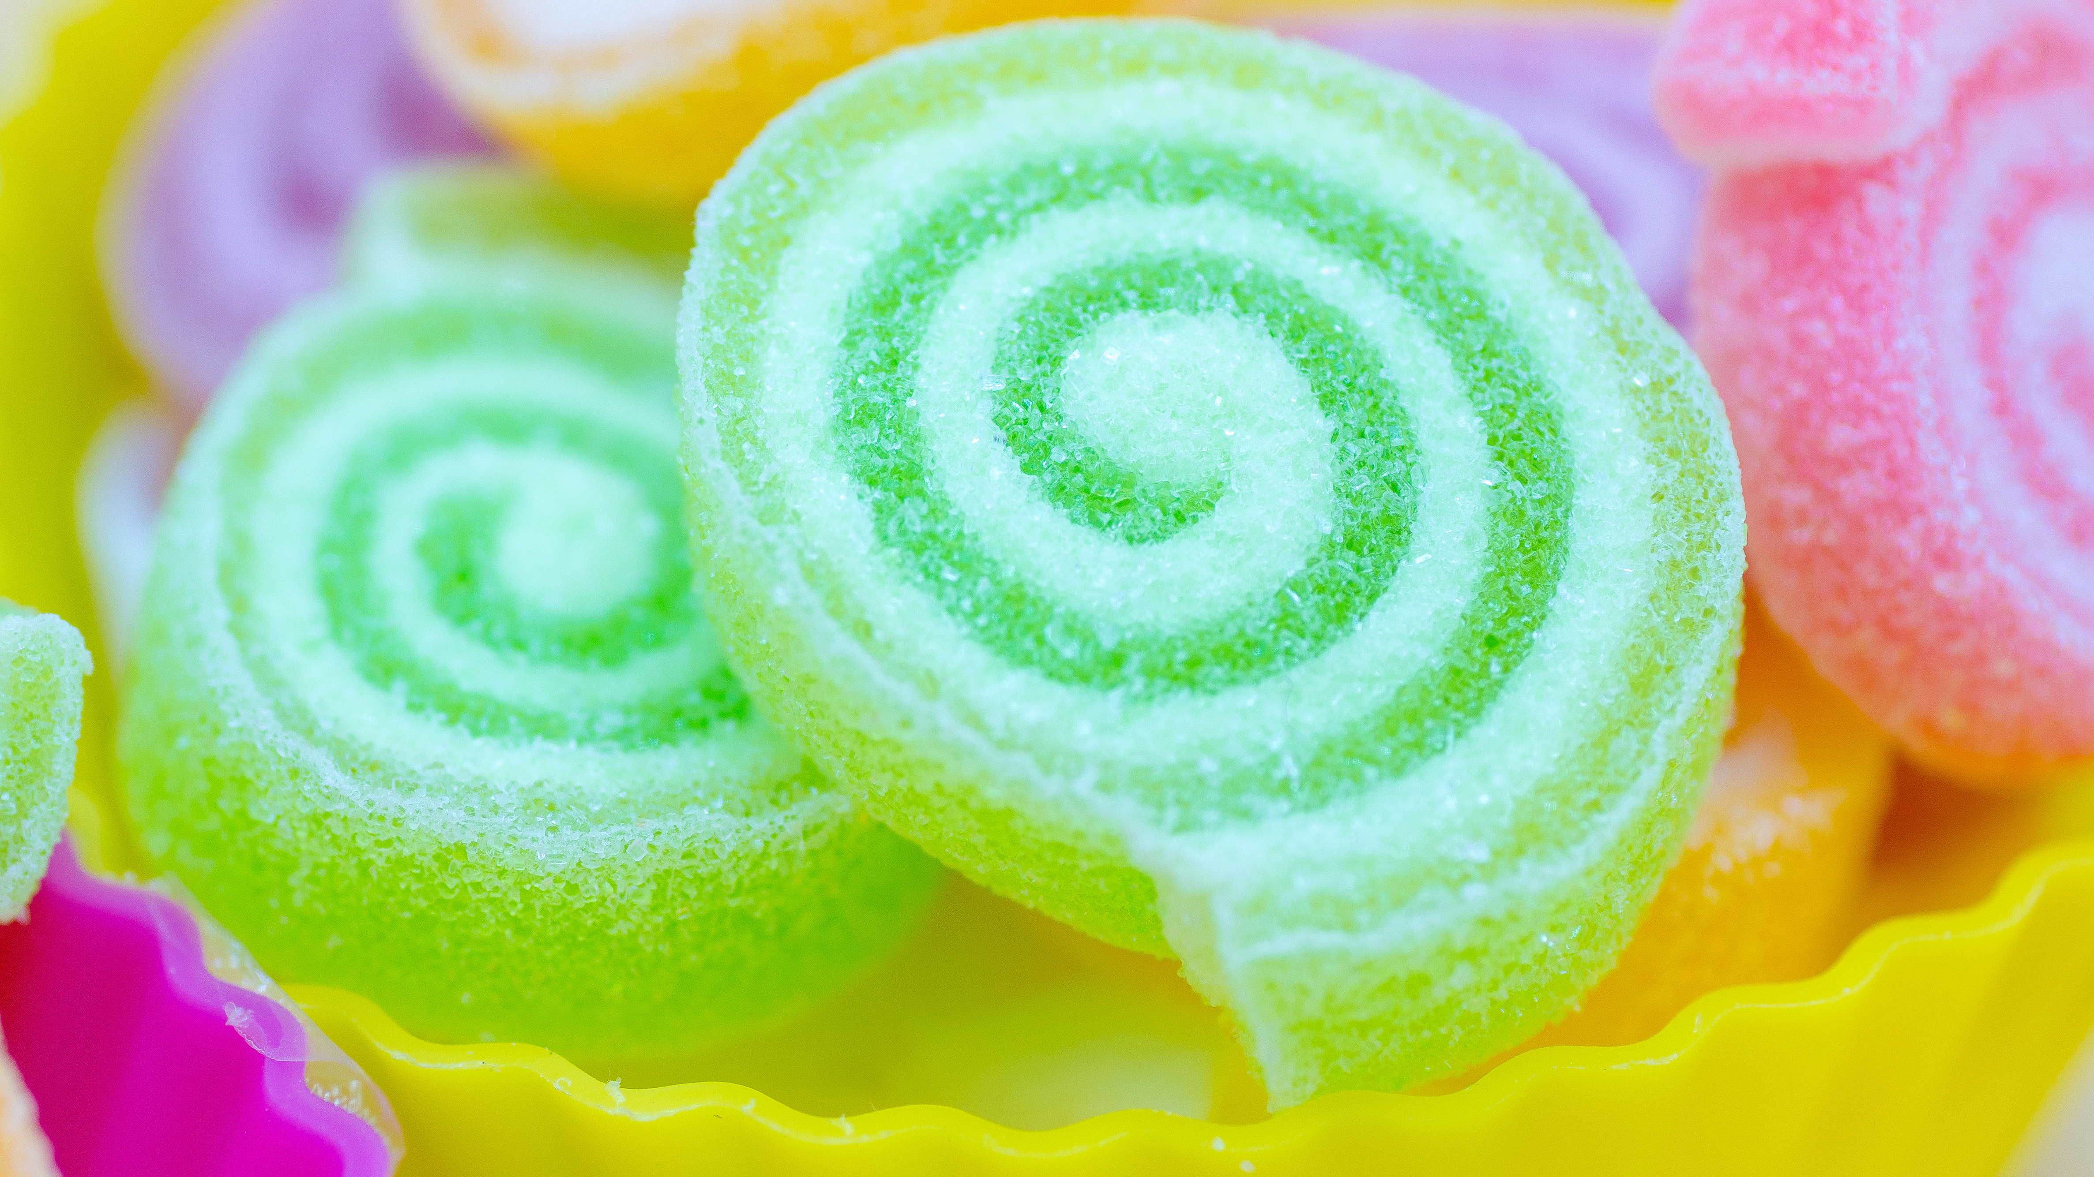
Agenda
Agenda
Data Set Description
Data Set EDA
DATA Set Machine Learning
Machine Learning Outcome Analysis
Prediction

Slide 3
CANDY DATA SET

Slide 4
Candy Data Set
What’s the best (or at least the most popular) Halloween candy? That was the question this dataset was collected to answer. Data was collected by creating a website where participants were shown presenting two fun-sized candies and asked to click on the one they would prefer to receive. In total, more than 269 thousand votes were collected from 8,371 different IP addresses.
For our Data Set we had 85 rows & 13 Columns of Data.
We had the name of candy, sugarpercent, pricepercent and the winpercent
All other columns were type of candies
We had to analyse and choose the most preferred candy type

Slide 5
Exploratory data Analysis (EDA)

Slide 6
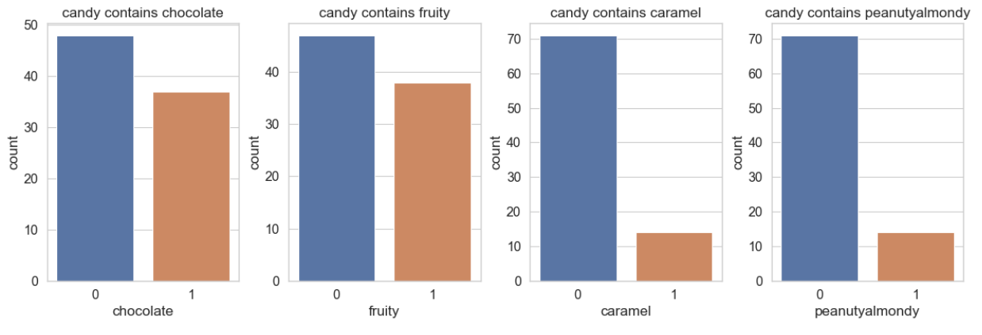
Candy contains-1, does not contain- 0

Slide 7
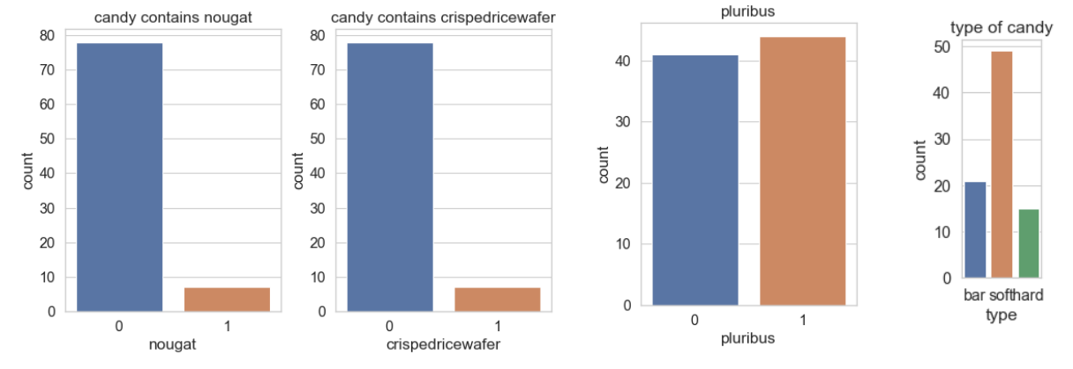
Candy contains-1, does not contain- 0

Slide 8
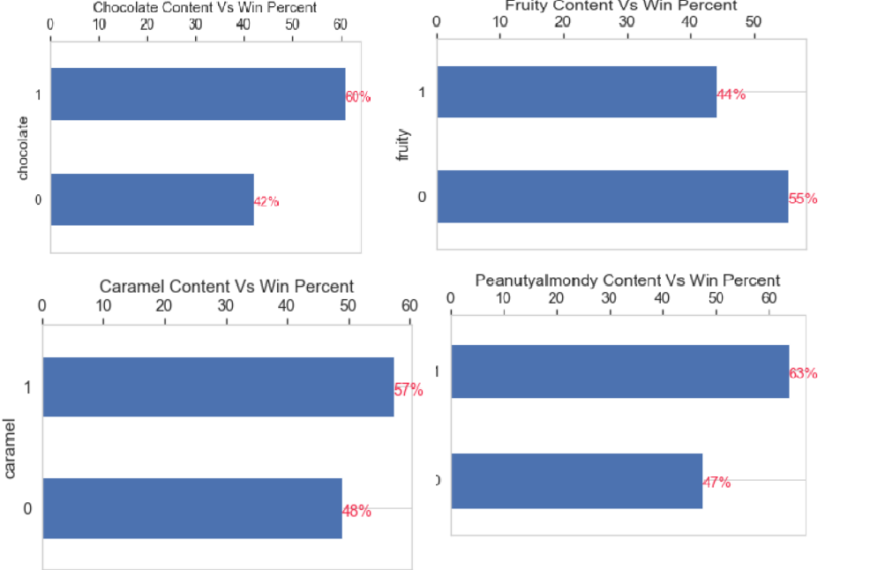
Vs. Winpercent

Slide 9
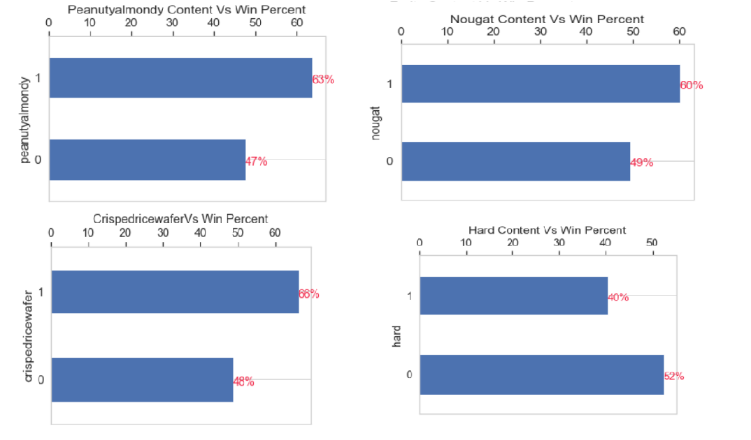
Vs. Winpercent

Slide 10
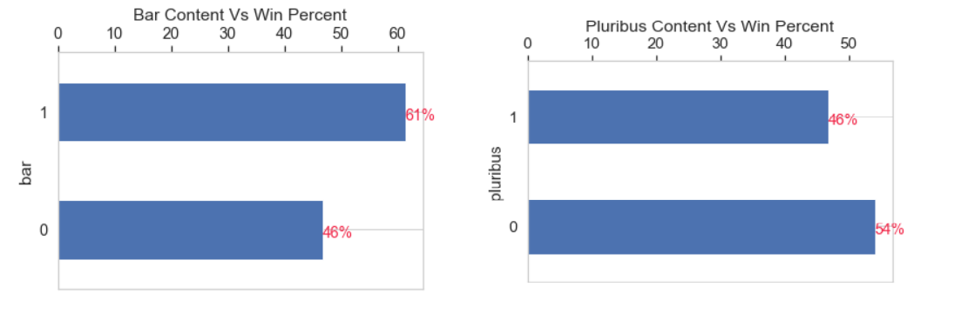
Vs. Winpercent

Slide 11
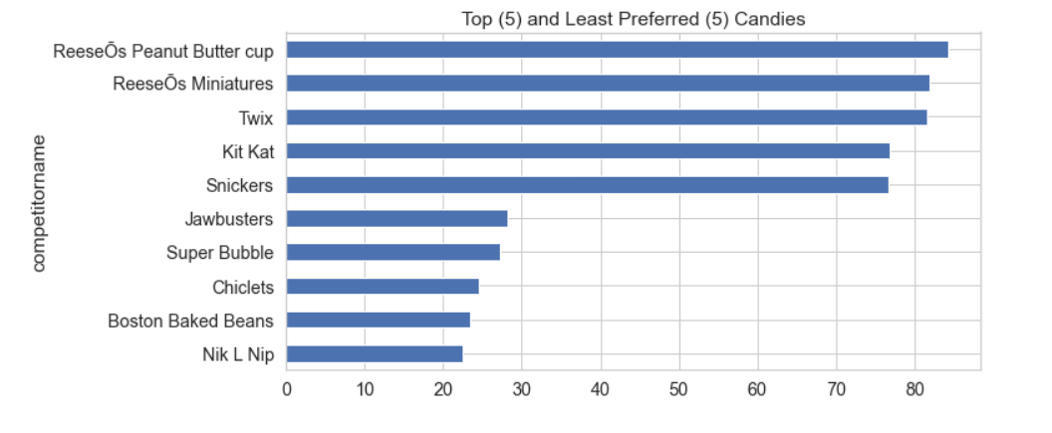
Preferred and Least Preferred Candies

Slide 12
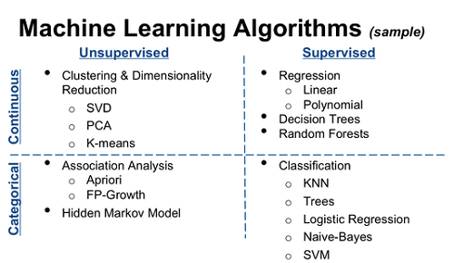
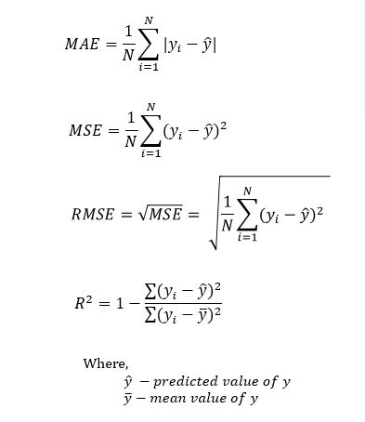
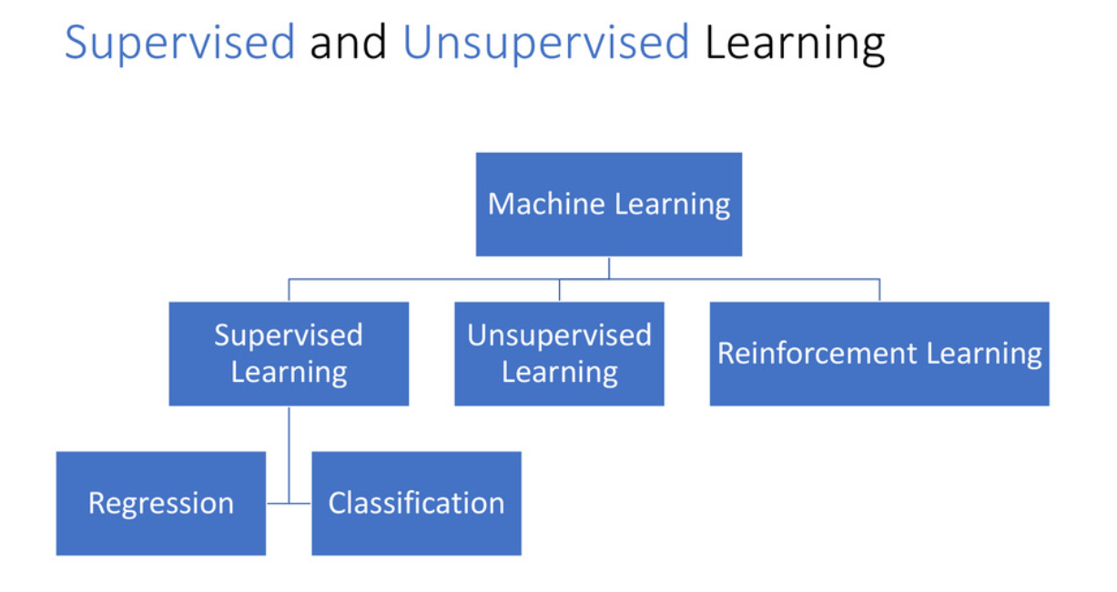
Models used to Evaluate
Linear Regression
Decision Tree
Manually Tuned
Tuned by Grid Search
Random Forest
Manually Tuned
Tuned by Random Search
Model Evaluation Metrics

Slide 13
Check if…
Multicollinearity is not present
The error term normally distributed

Slide 14
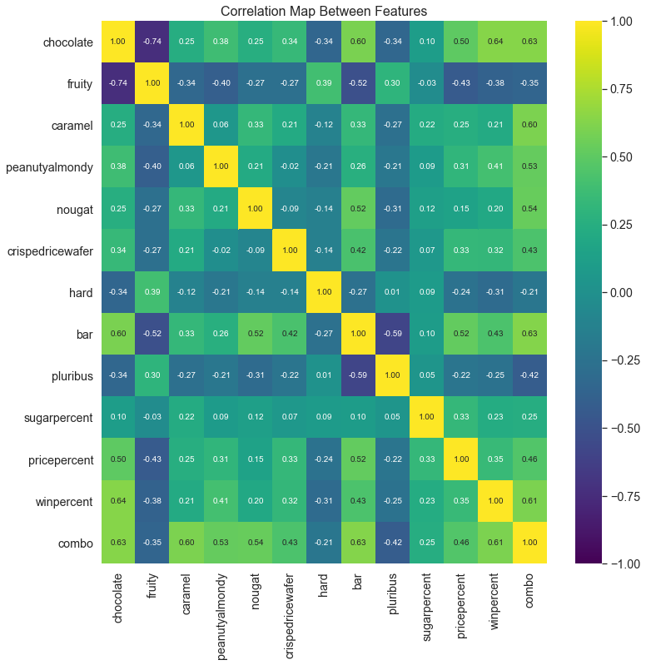
Chocolate is highly co-related to Winpercent.
There is no significant co-relation between the features.
Hence we can rule out multicollinearity

Slide 15
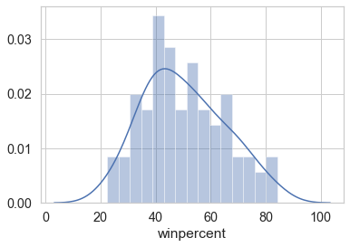
Target Variable - Normally Distributed ?
Observation: Winpercent (target variable) is normally distributed, so we can proceed with the model building

Slide 16
Train & Test:
Features & Target
features = ['chocolate', 'fruity', 'caramel', 'peanutyalmondy','nougat', 'crispedricewafer', 'hard', 'bar', 'pluribus', 'sugarpercent', 'pricepercent']
target = ['winpercent']
Test –Set 20%: Shape of Train & Test Set
Train cases as below
X_train shape : (68, 11)
y_train shape: (68, 1)
***************************
Test cases as below
X_test shape: (17, 11)
y_test shape: (17, 1)

Slide 17
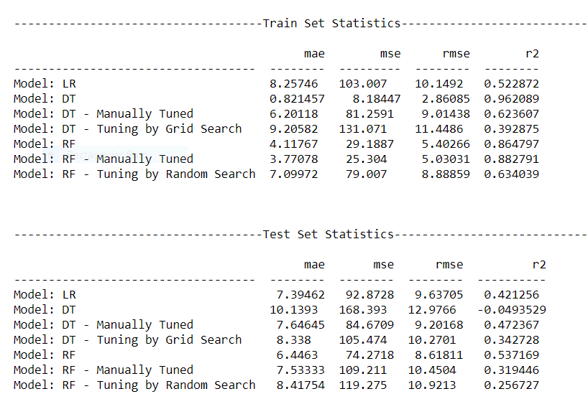
All Machine Learning Algorithm Statistics for Train & Test

Slide 18
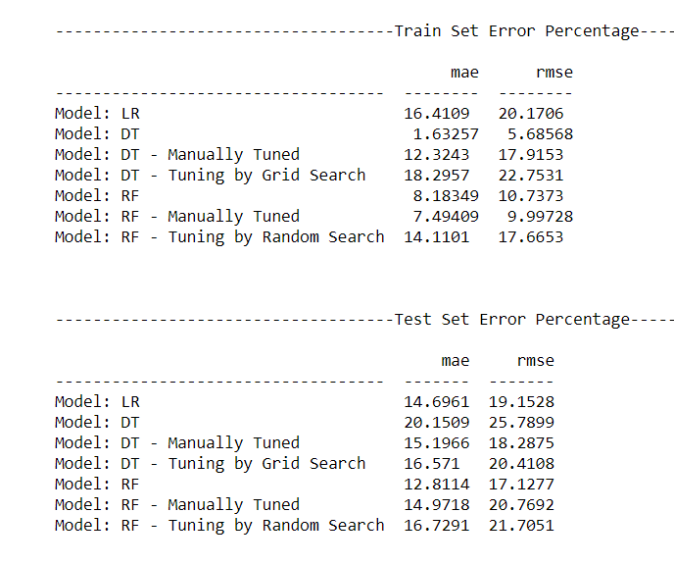
Model Evaluation- Error Percentage

Slide 19
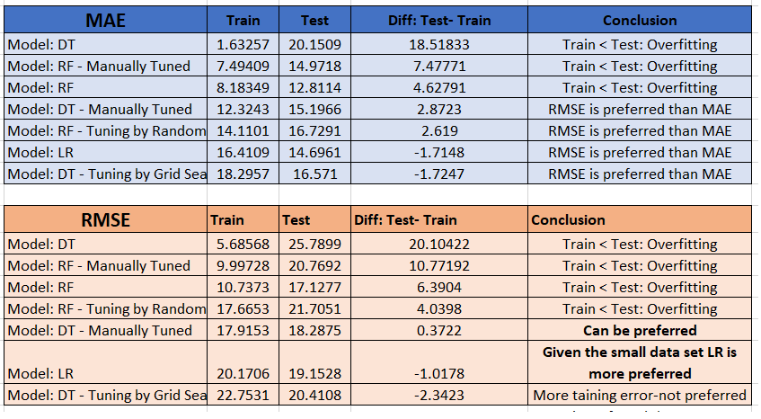
Model Evaluation- Error Percentage- Analysis & Conclusion

Slide 20
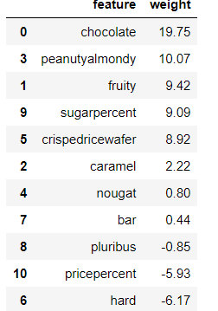
Linear Regression Equation & Conclusion
'winpercent = + 19.748 * chocolate + 9.422 * fruity + 2.224 * caramel
+ 10.071 * peanutyalmondy + 0.804 * nougat + 8.919 * crispedricewafer
- 6.165 * hard + 0.442 * bar - 0.854 * pluribus
+ 9.087 * sugarpercent - 5.928 * pricepercent + 34.534'
Considering the complete data set, the average winning rate is 50.3% in 85 products.
As per the evaluation with (80:20) training and testing data
Chocolate is the most important attribute of a candy followed by Peanutyalmondy and crispedricewafer
The candy need not be fruit flavored
The candy must NOT be hard
The candy might or might NOT be bar
The candy might or might NOT be one of the many candies in the box or bag
The candy must have sugar content
The candy must be priced in the low range

Slide 21




